Slide 1
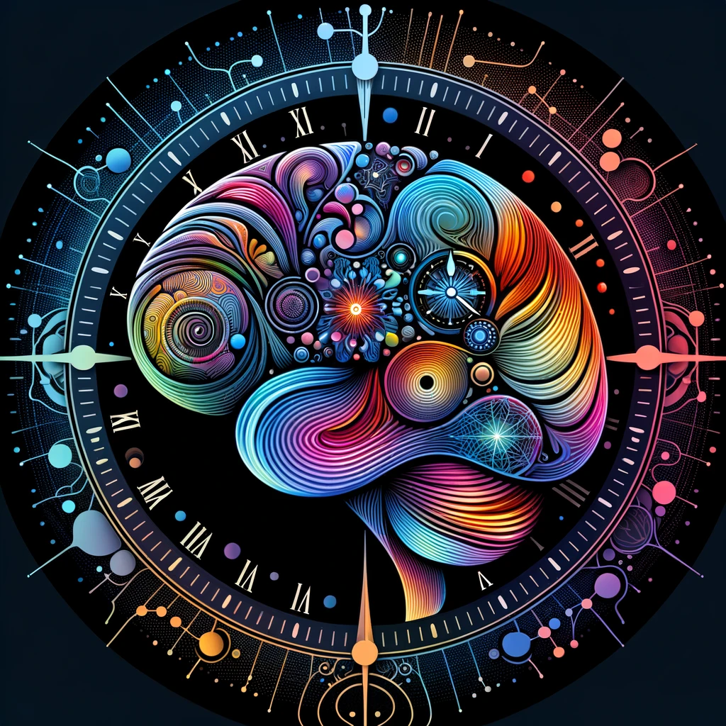
Characterization of the Intrinsic Neural Timescale Indices as a Reliable Fingerprint of Brain Dynamics
Helya Honarpisheh
Biomedical Engineering
The City College of New York
May 2026
Notes:
how our brains process time, why it matters, and how we can measure these patterns as diagnostic signatures of brain function.

Slide 2
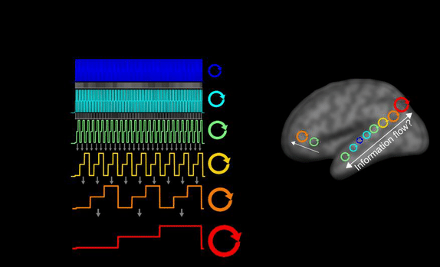
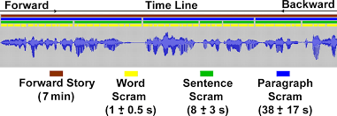
INTs and Temporal Hierarchy
Based on relational time concept
Short timescales: sensory areas
Long timescales: DMN, prefrontal
Notes:
Introduction to the concept of intrinsic neural timescales, or INTs. Our brains don’t process all information at the same speed. Sensory areas, like those for vision or hearing, respond rapidly to brief stimuli-think of a flash of light or a single note. In contrast, regions like the prefrontal cortex or the default mode network operate over much longer timescales, integrating information across seconds or even minutes. This temporal hierarchy allows us to both react to immediate events and build up complex, meaningful experiences over time.

Slide 3






Input Processing
Notes:
To visualize this, imagine watching a movie. This is a highly active cognitive process that requires your brain to integrate and segregate information across multiple timescales. Spoken language, for example, is processed as words, sentences, and paragraphs-each operating on different durations. Meanwhile, your brain is also processing background music and visual effects, each with their own temporal patterns. The brain’s ability to combine and distinguish these diverse timescales is what creates a coherent, immersive experience.

Slide 4
INTs in ASD and ADHD
• Altered timescales in sensory & associative regions
• Atypical temporal integration
• Diagnostic potential
Notes:
Why Study Neural Timescales? For example, disruptions in neural timescales have been observed in conditions like autism spectrum disorder (ASD) and attention-deficit/hyperactivity disorder (ADHD). These findings suggest that atypical temporal processing may underlie some of the cognitive and behavioral symptoms seen in these disorders. By characterizing INTs, we can potentially identify biomarkers for early diagnosis and intervention.

Slide 5
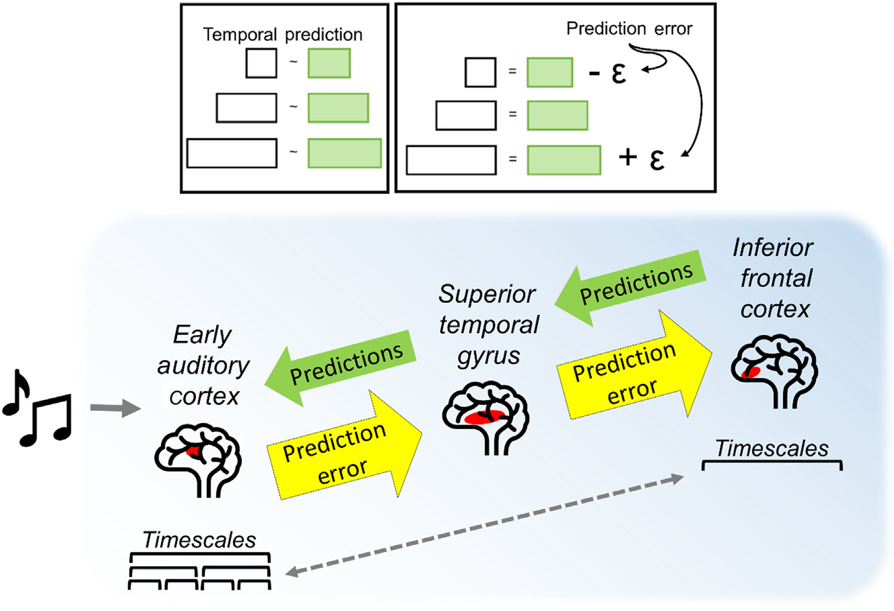
From temporal integration/segregation to prediction
Notes:
According to predictive coding theory, higher-order brain regions use longer timescales to generate predictions about incoming sensory information. These predictions are compared with actual inputs, and errors are sent back up the hierarchy to refine future predictions. This dynamic interplay relies fundamentally on the temporal hierarchy of INTs, with different regions contributing at different timescales.

Slide 6

Can INTs serve as a diagnostic fingerprint for individual brain dynamics?
• Compare six INT metrics
• Evaluate discriminability
• Study development effects
Notes:
To characterize different metrics for measuring INTs in the human brain,
To evaluate their reliability and discriminability as individual “fingerprints” of brain dynamics, and
To assess how these measures vary across the lifespan, between sexes

Slide 7
Dataset Overview
• Multiband Resting State fMRI @ 3 TRs = 645, 1400, 2500 ms
• 1022 participants
• NKI-RS: lifespan dataset (6–85 yrs)

Slide 8
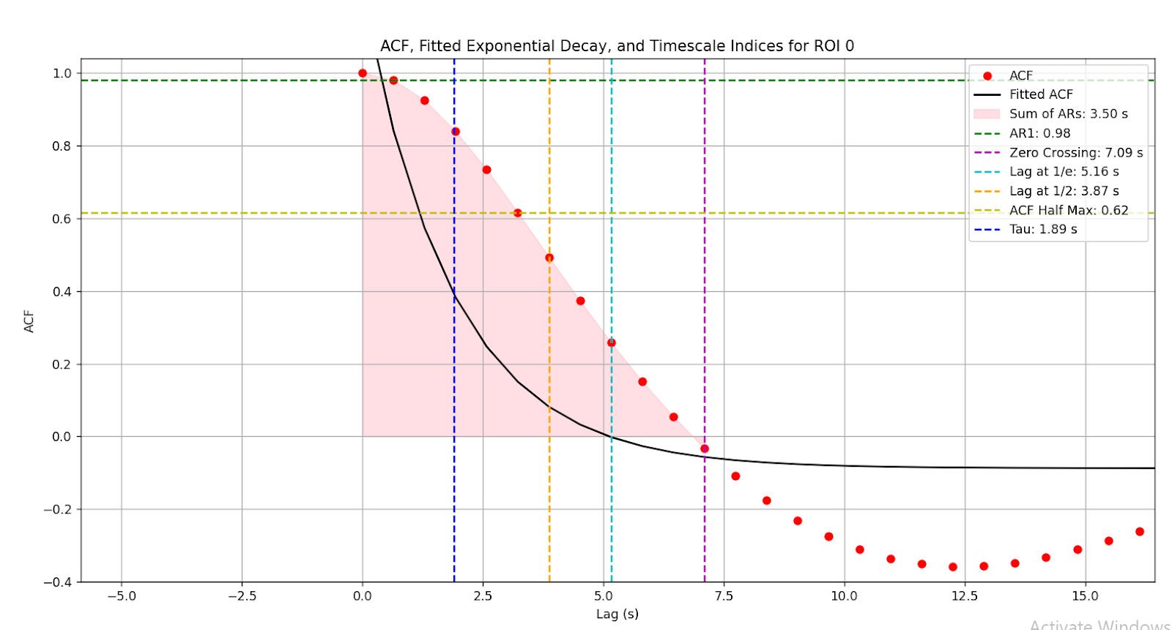
Measuring INTs
Notes:
Multiple metrics exist, each capturing different aspects of temporal dynamics. In this study, I compared several commonly used indices, such as the autocorrelation function at various lags, autoregressive coefficients, and the sum of autocorrelations across time. Each metric provides a unique window into the brain’s temporal processing.

Slide 9
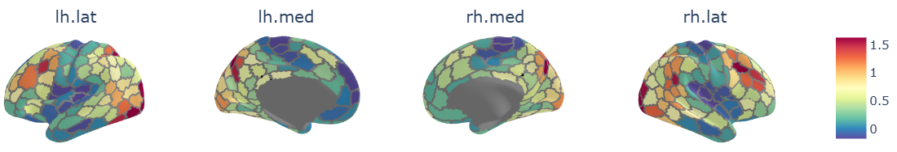
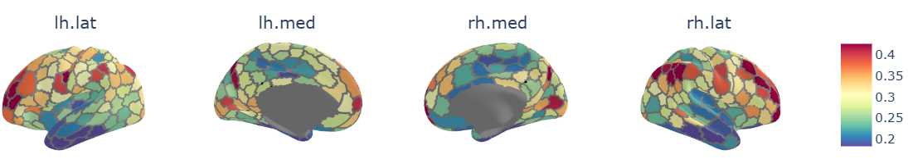
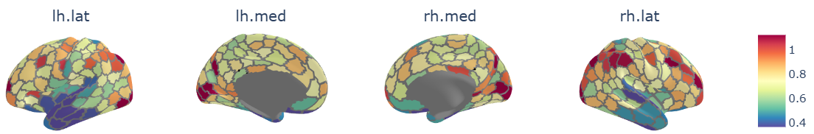
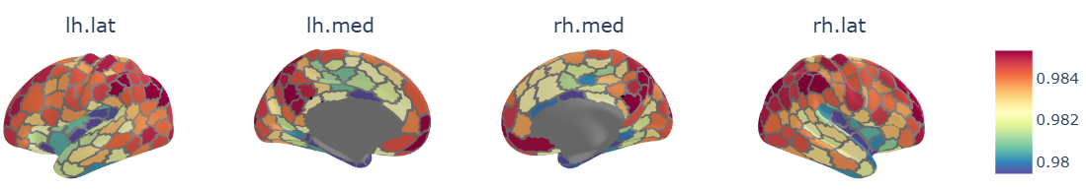
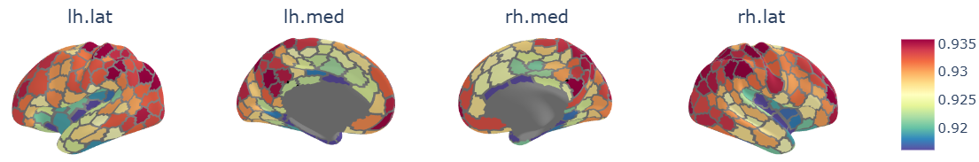
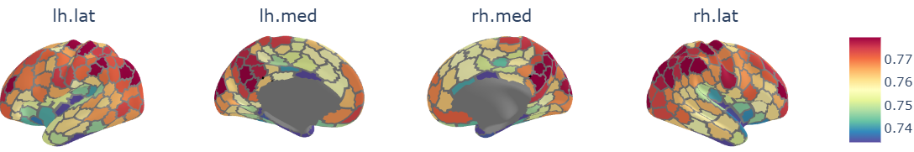
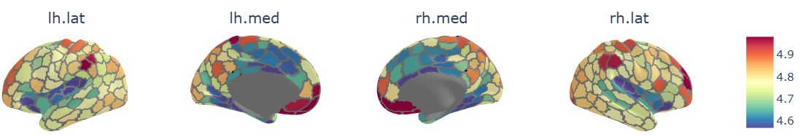
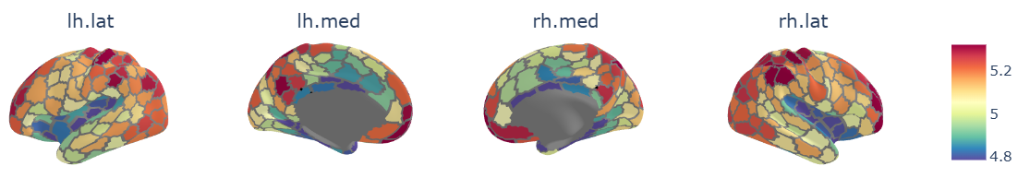
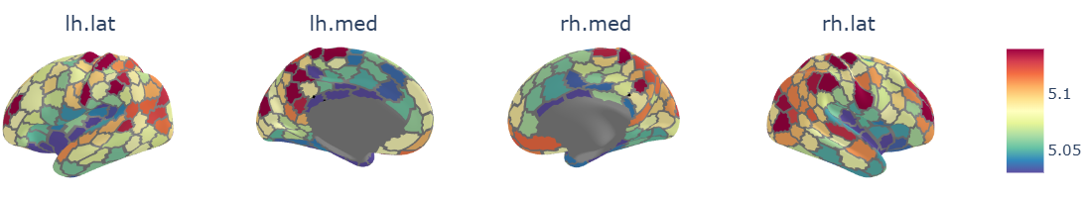
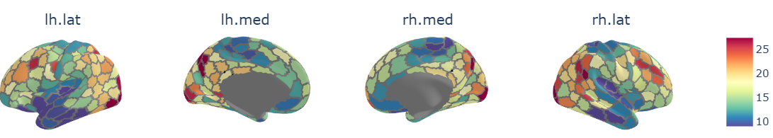
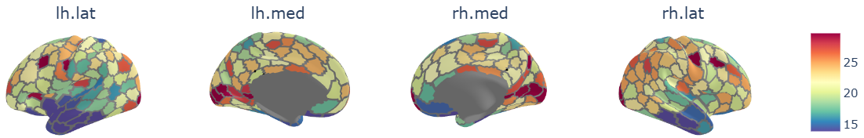
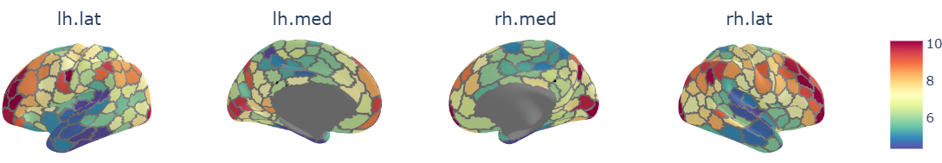
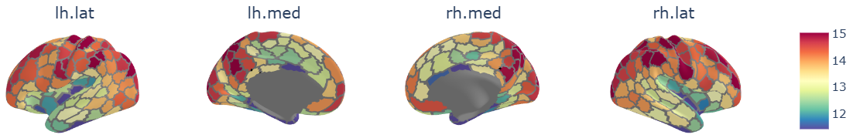
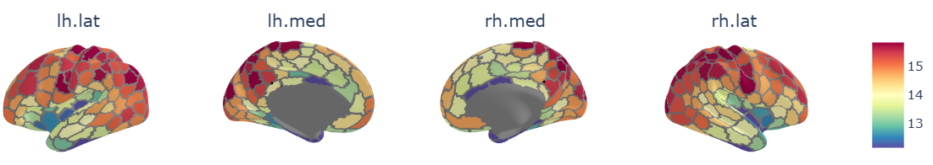
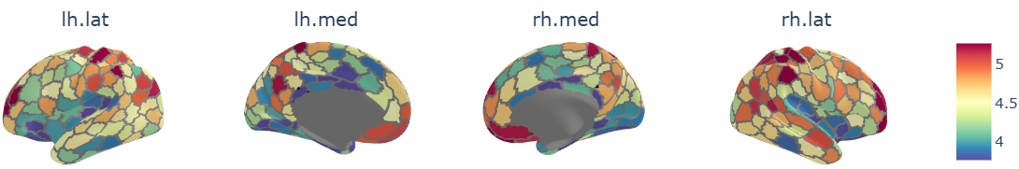
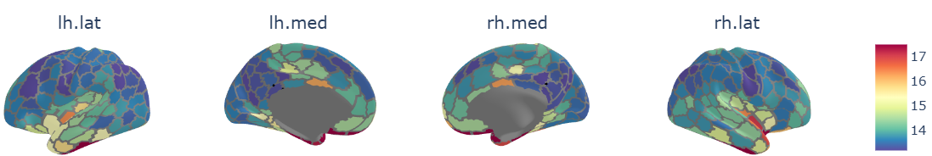
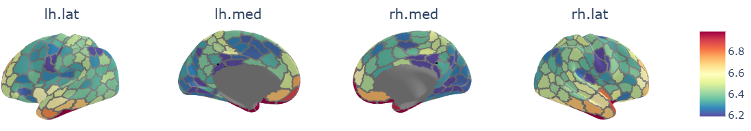
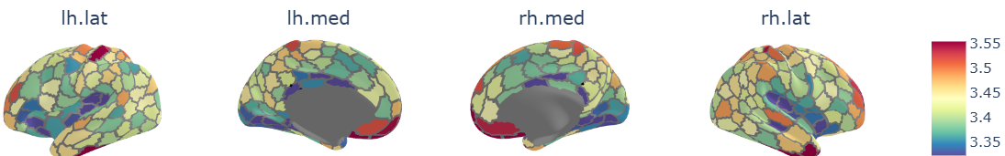
INT Metrics Spatial Brain Maps Across TRs
TR=645 ms
TR=1400 ms
TR=2500 ms
acf@half lag
AR1
lag@acf=1/e*TR
Sum of ACFs*TR
tau
lag@acf=0
Notes:
These maps reveal consistent gradients from unimodal sensory regions to transmodal association areas, reflecting the brain’s temporal hierarchy.

Slide 10
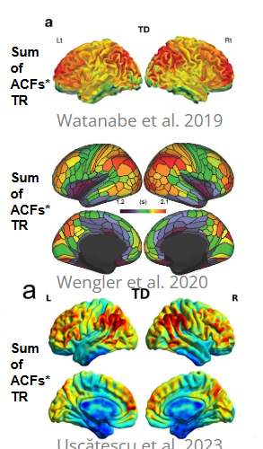
Sum of ACFs*TR (Area Under the First Positive ACF)
Uscătescu et al. 2023
Notes:
Validated against prior studies

Slide 11
Discriminability Analysis
Measures test–retest reliability
Most reliable index
Validated for further use
Your brain should look more like itself than like others’
Within-person similarity > Between-person similarity
Score ranges from 0.5 (random) to 1.0 (perfect individual fingerprint)
Notes:
A key question is whether these INT patterns are unique to individuals-can they serve as a “fingerprint” of brain dynamics? I conducted discriminability analyses to test how well INT maps can distinguish between individuals, even across different scanning sessions.
For each person, compute the distance between their two scans (how different they are).
Also compute the distances between their scans and everyone else’s.
If within-person scans are consistently more similar than between-person ones → high discriminability.

Slide 12
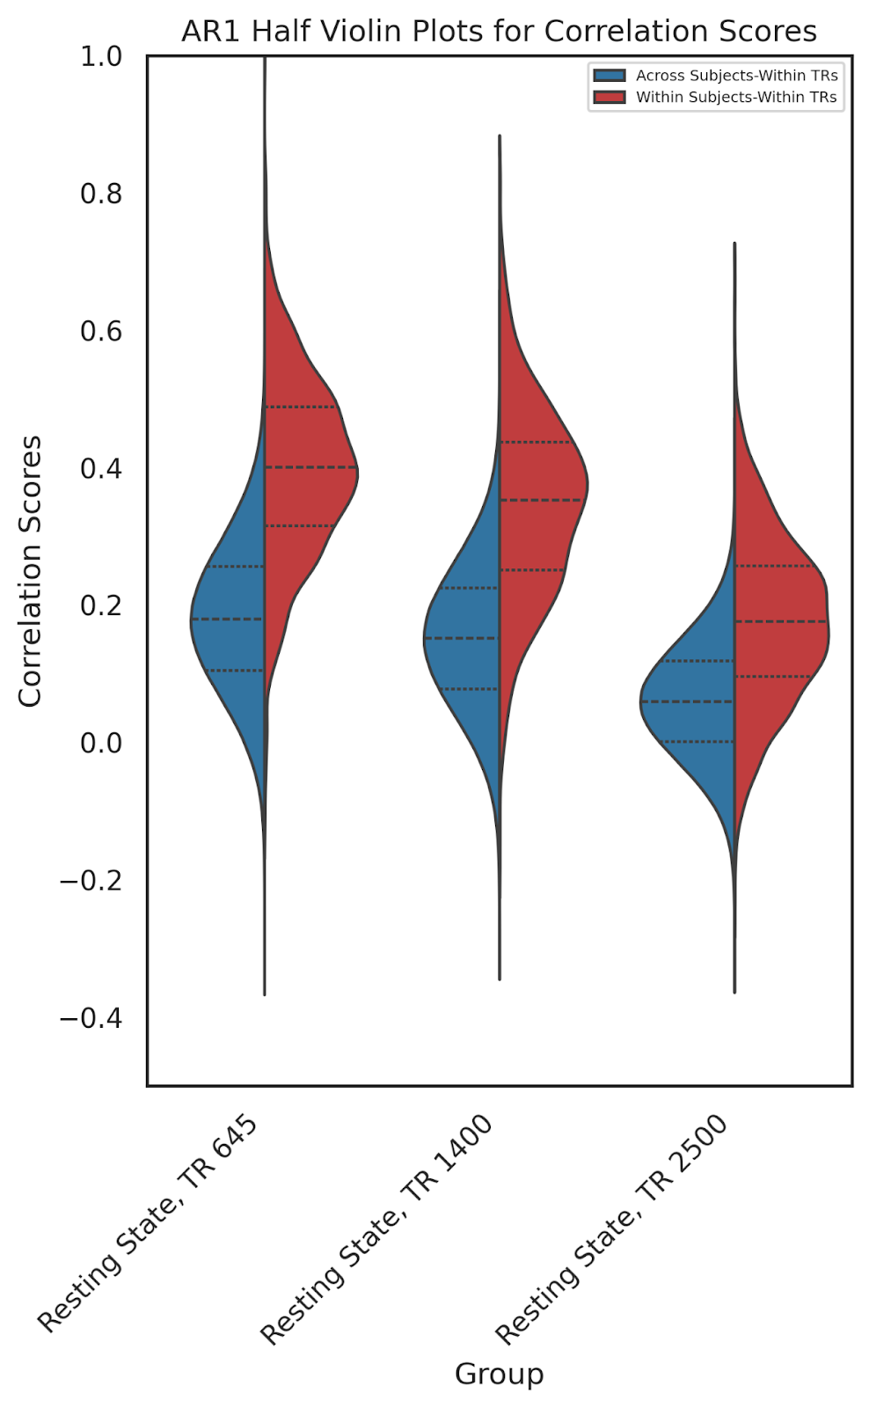
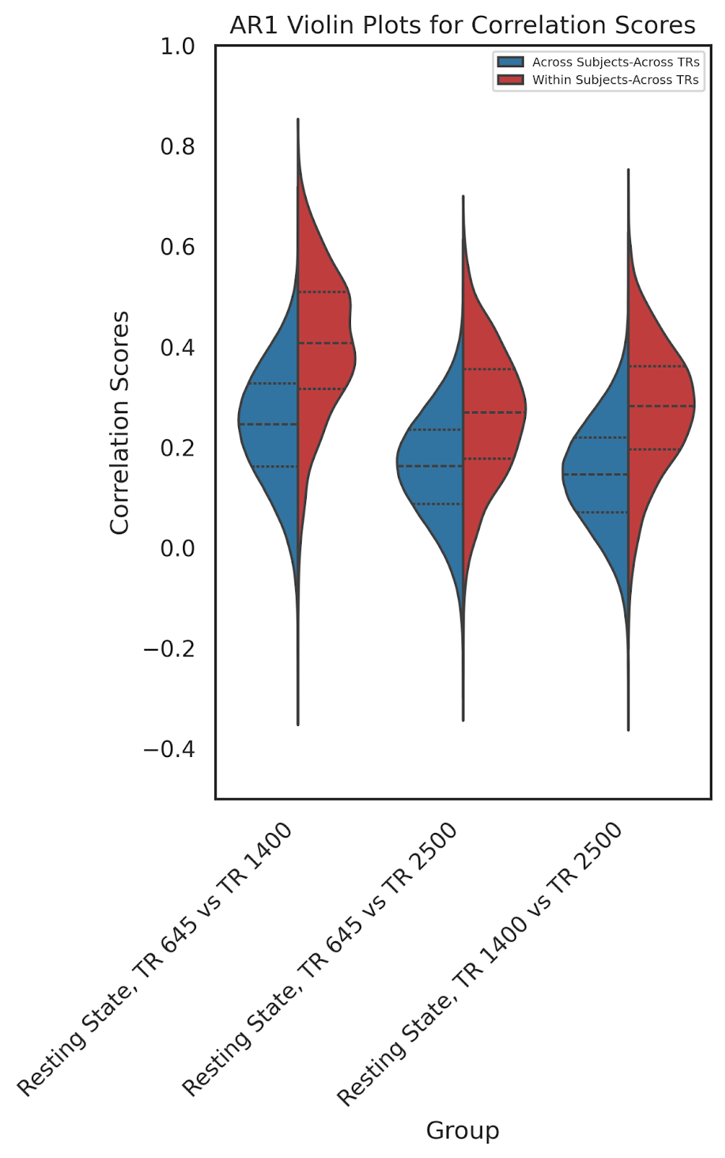
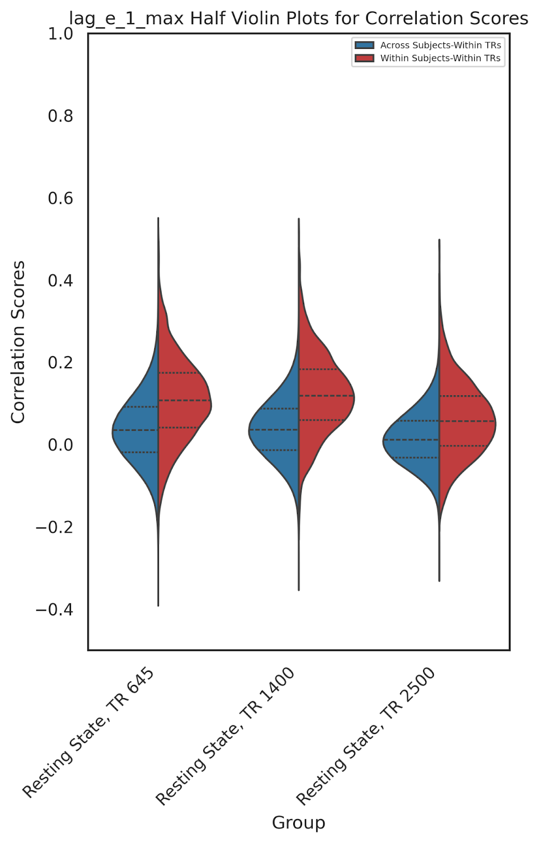
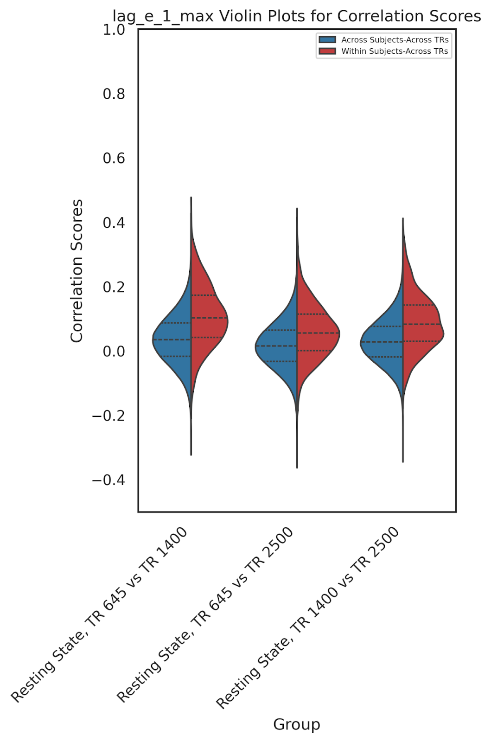
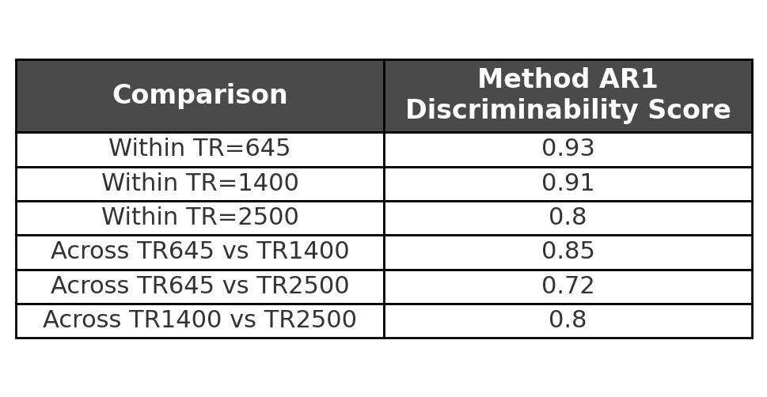
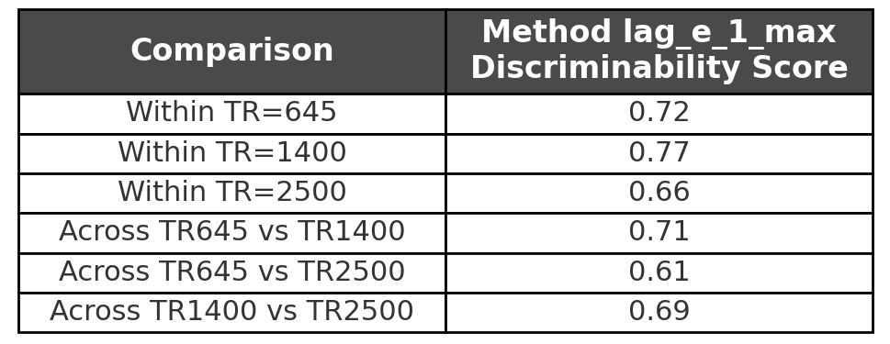
Discriminability Scores
12

Slide 13
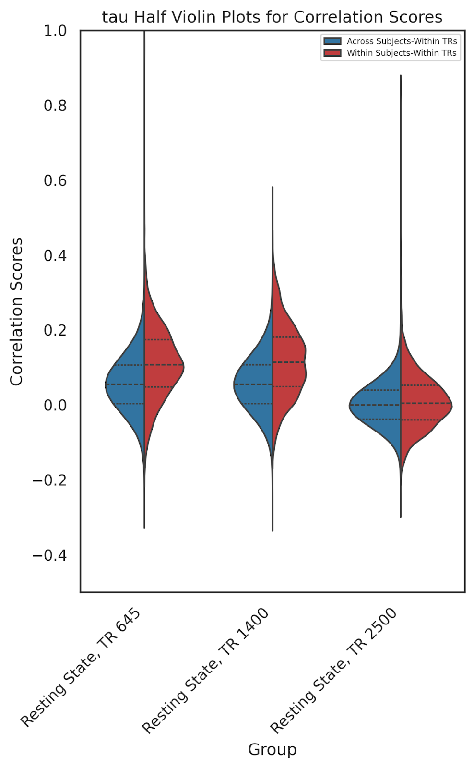
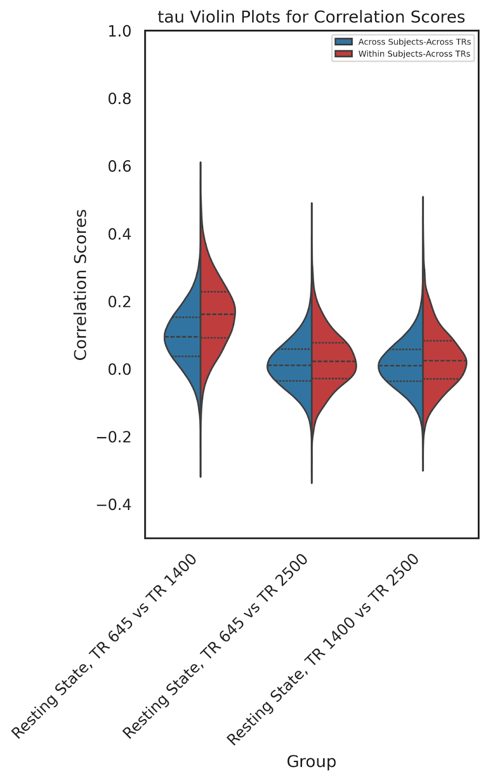
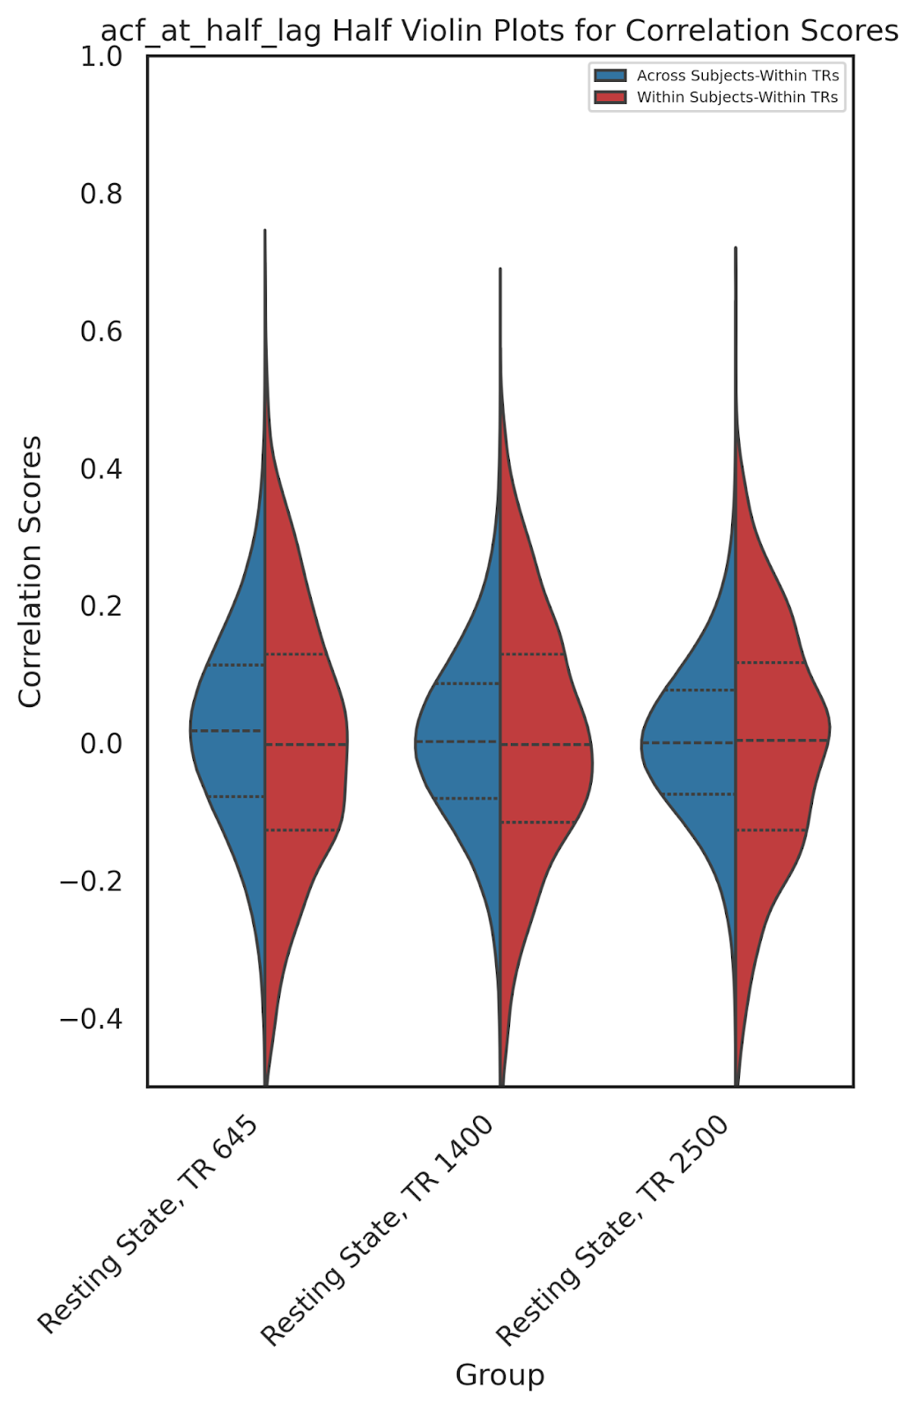
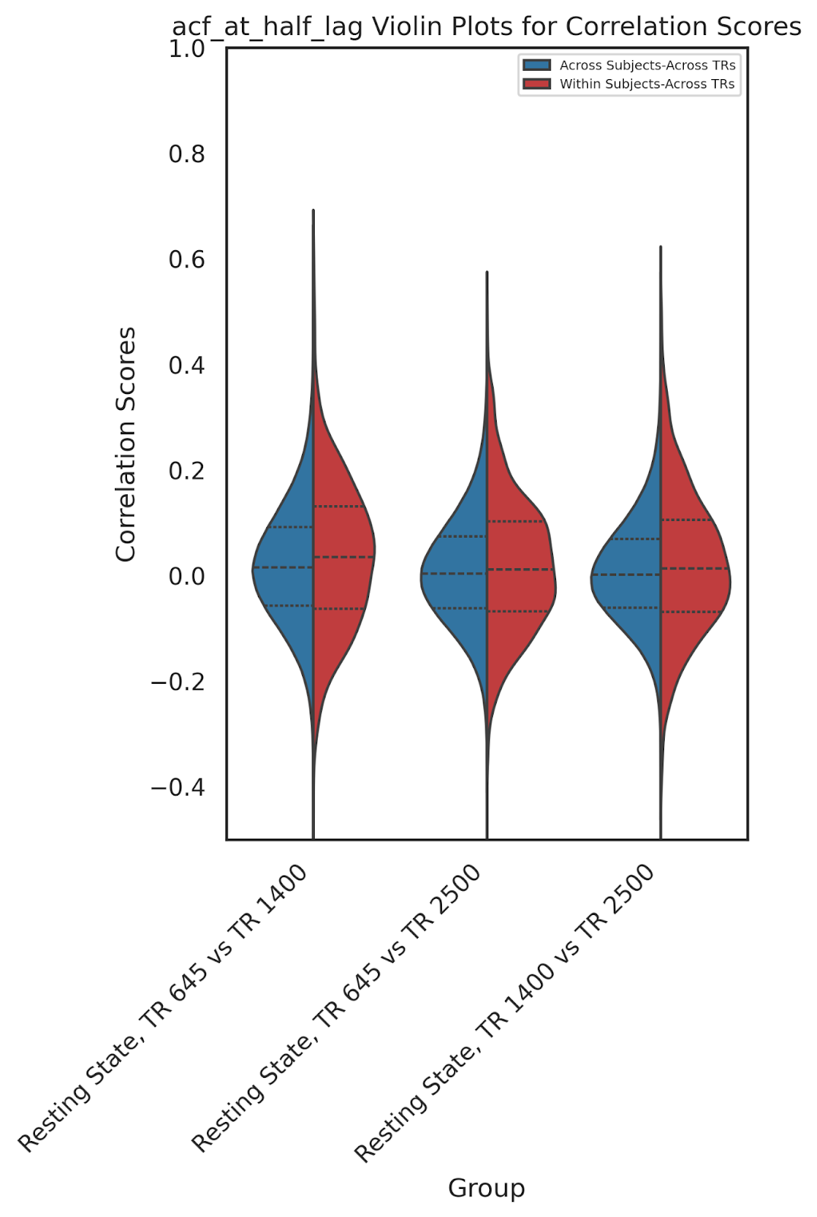
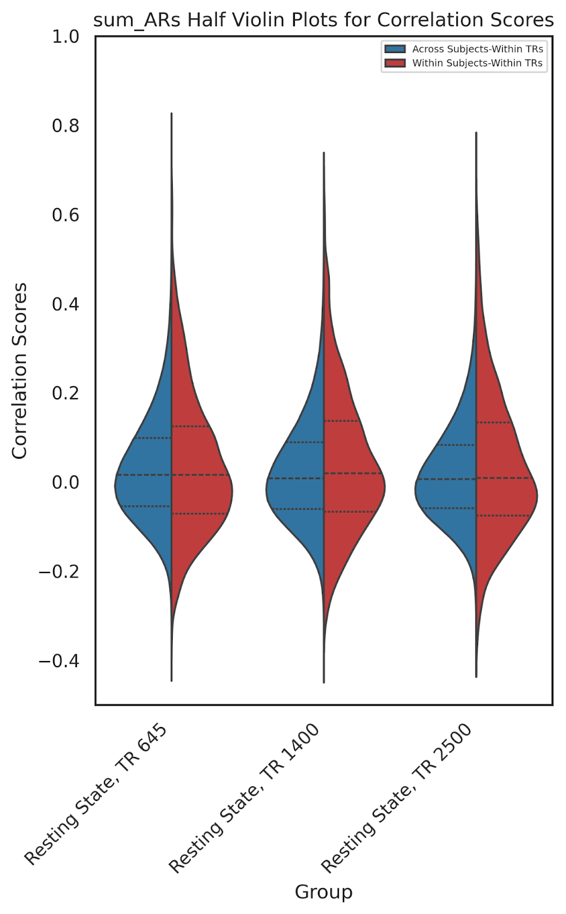
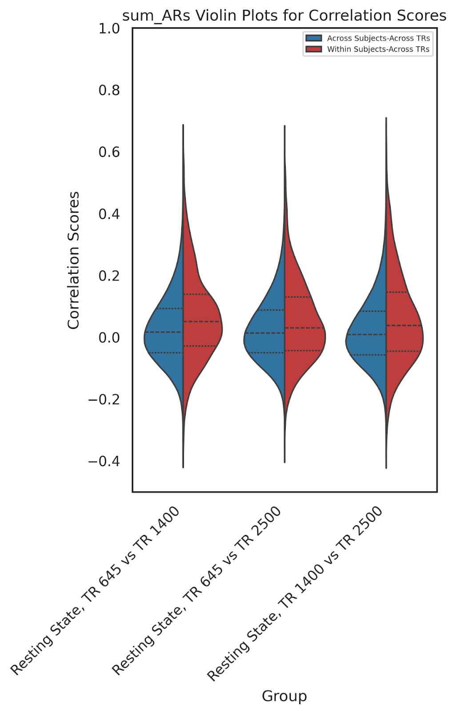
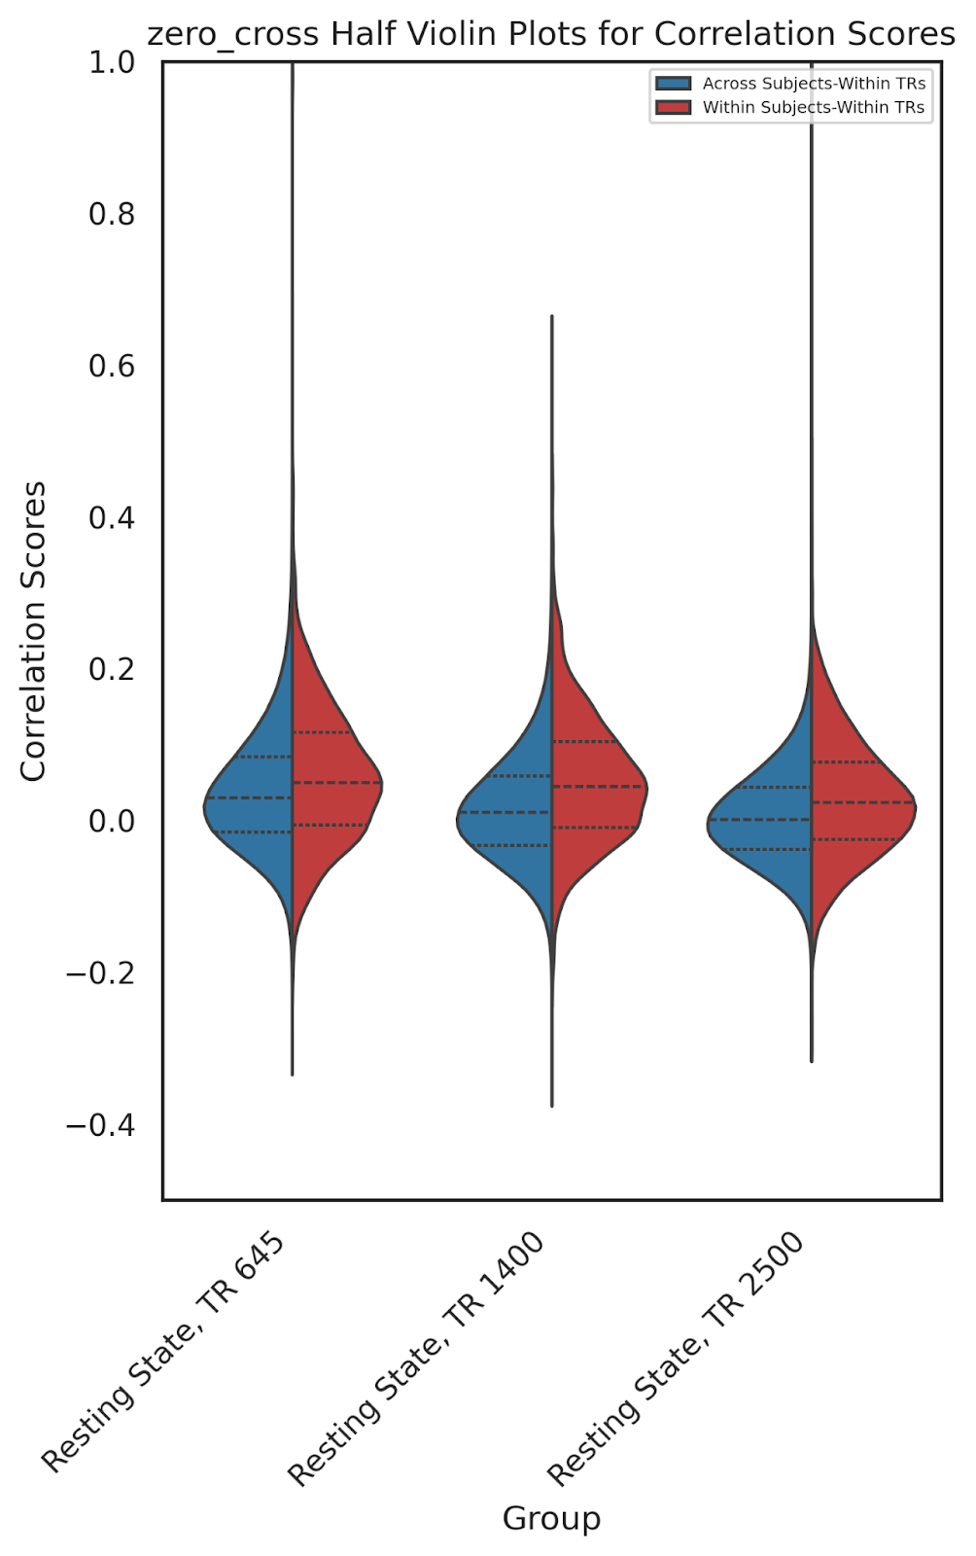
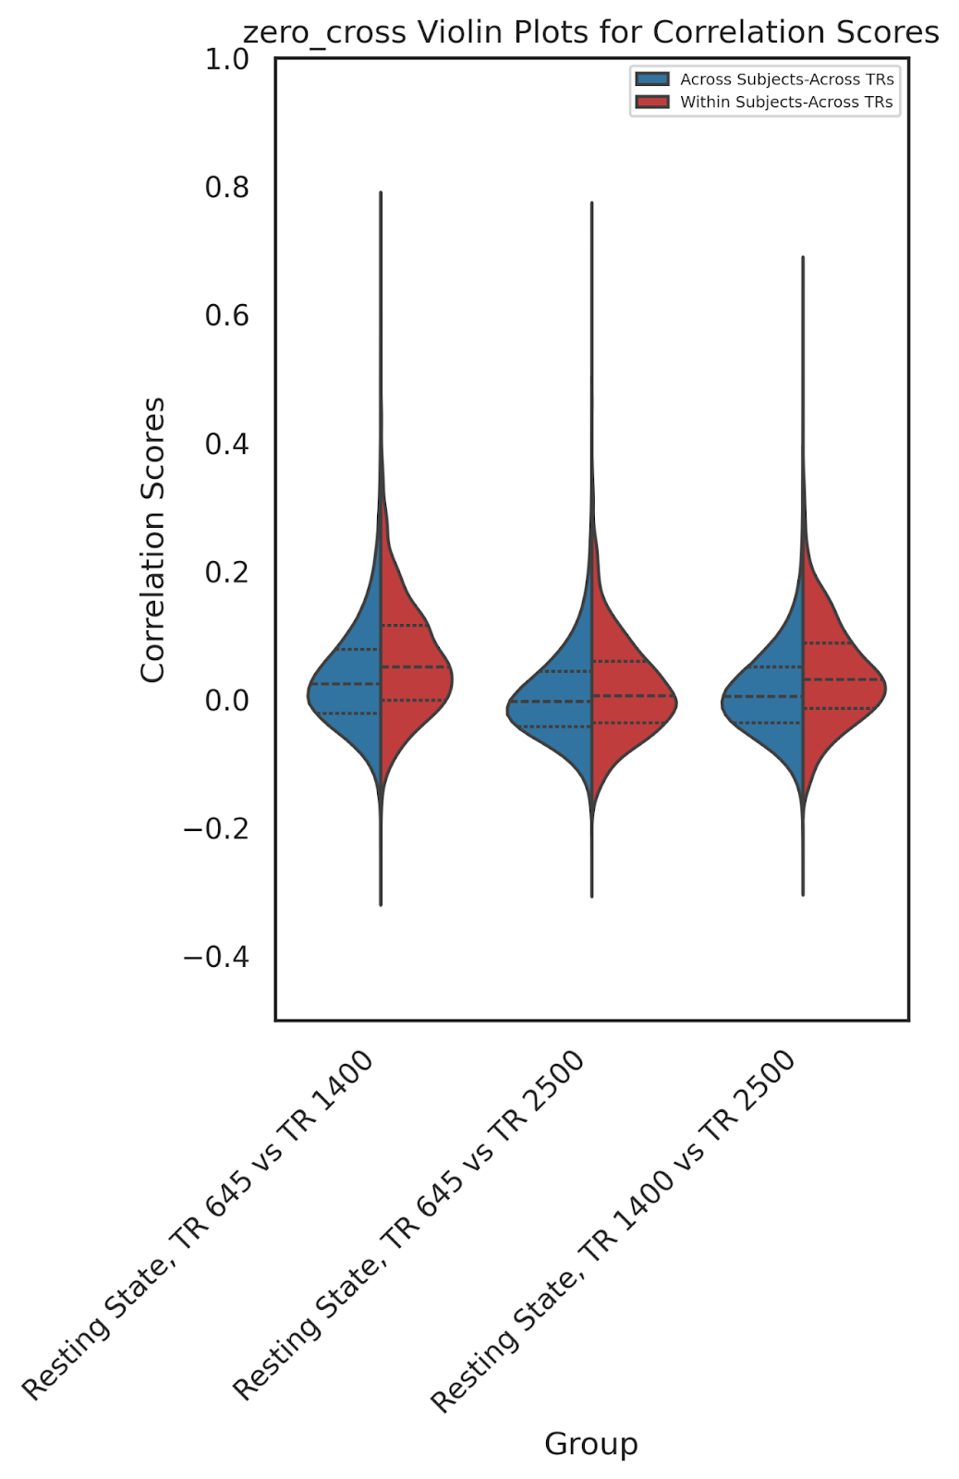
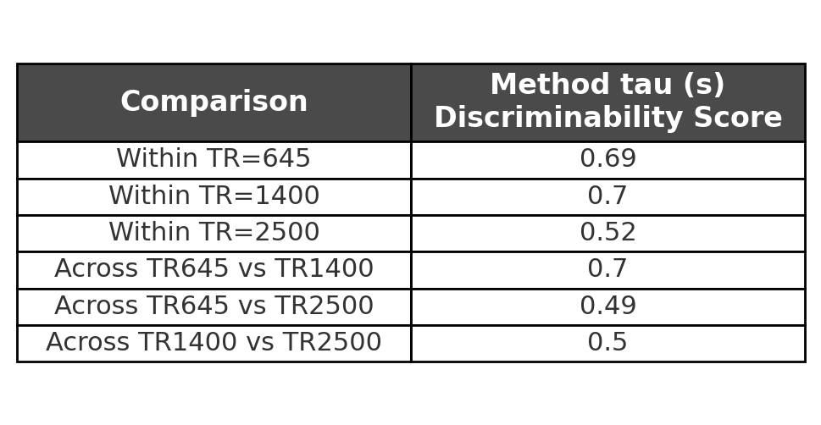
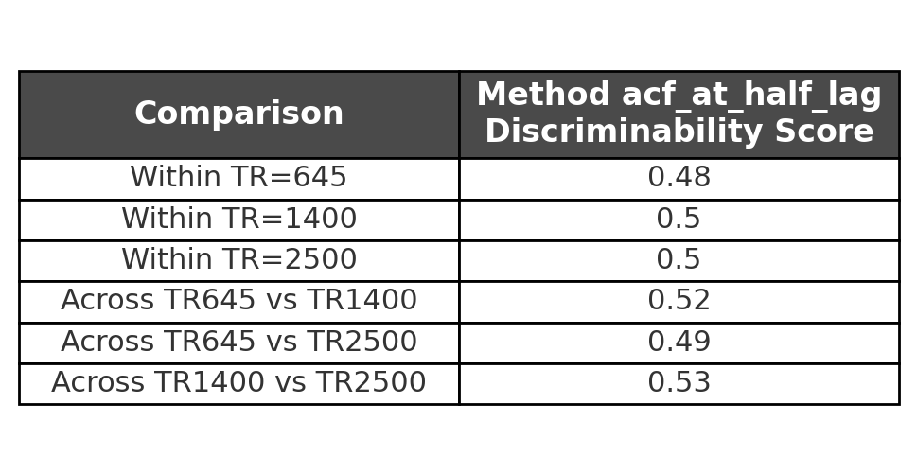
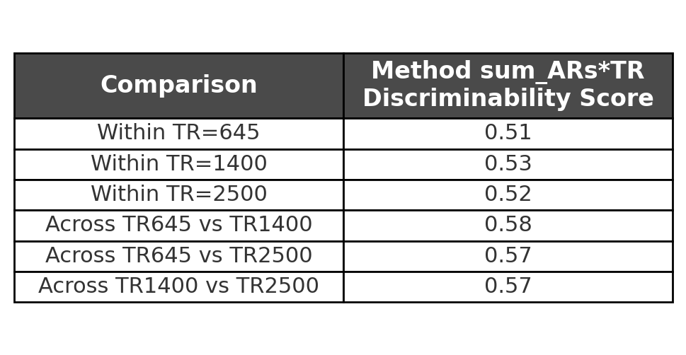
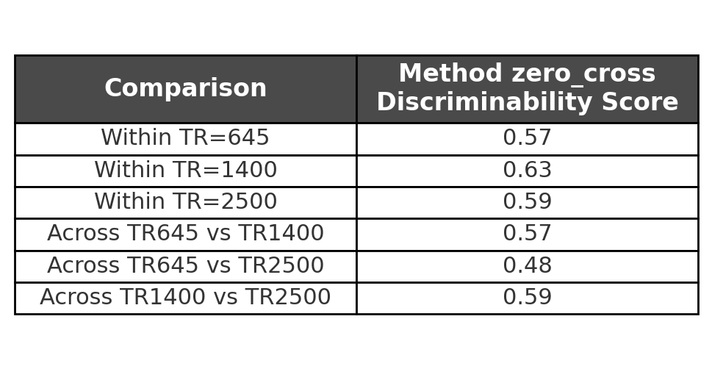
Discriminability Scores

Slide 14
Linear Mixed-Effects Model
AR(1) = β₁·Age + β₂·Age² + β₃·Sex + β₄·Head Motion + β₅ .Age * Sex
Age, Age²: Linear and quadratic age terms to capture nonlinear lifespan trends
Sex: Binary variable
Head Motion: Mean framewise displacement (FD), included as a covariate
Age * Sex : Age and Sex Interaction
Notes:
To examine the effects of age, sex, and head motion on intrinsic neural timescales, we fit the following linear mixed-effects model:
where AR(1) represents the autoregressive coefficient at lag-1 for each cortical region. Age was modeled both linearly and quadratically to capture potential nonlinear lifespan effects. Sex and head motion were included as fixed effects, and subject ID was treated as a random intercept to account for repeated measures.

Slide 15
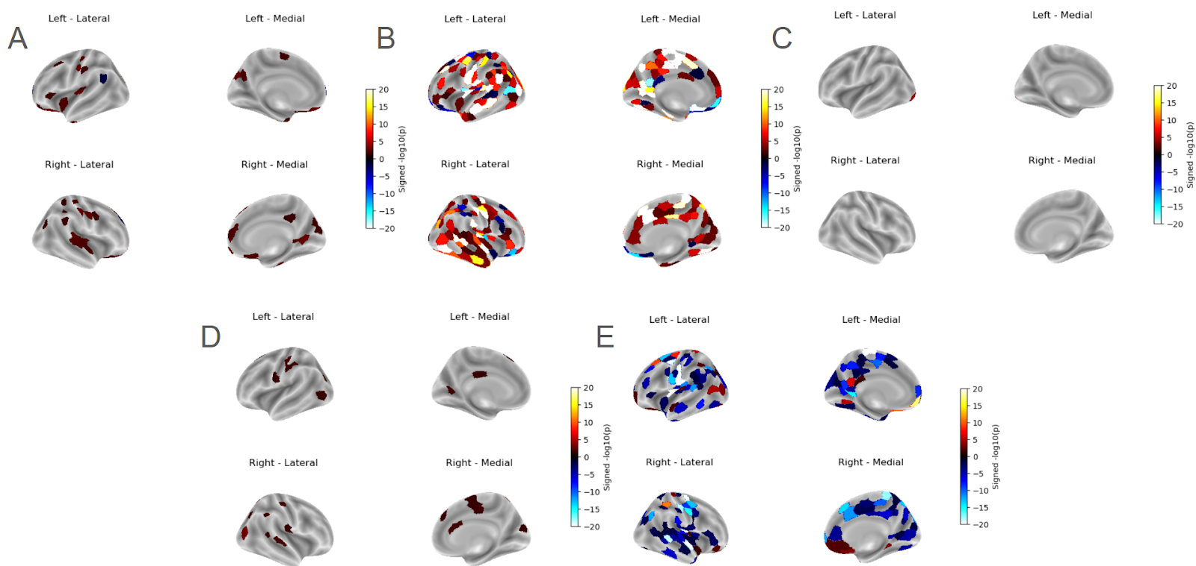
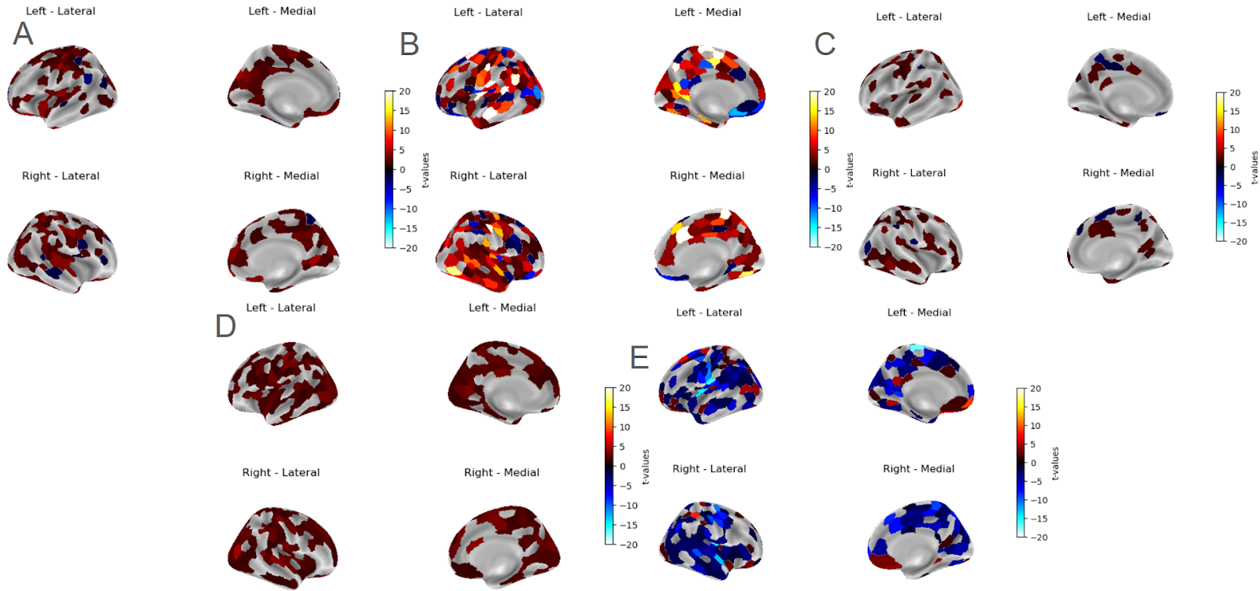
Statistical Modeling @ TR=645 ms
-log(P)
T maps
Head Motion
Age
Sex
Head Motion
Age
Sex
Age*Sex
Age Quadratic
Age*Sex
Age Quadratic

Slide 16
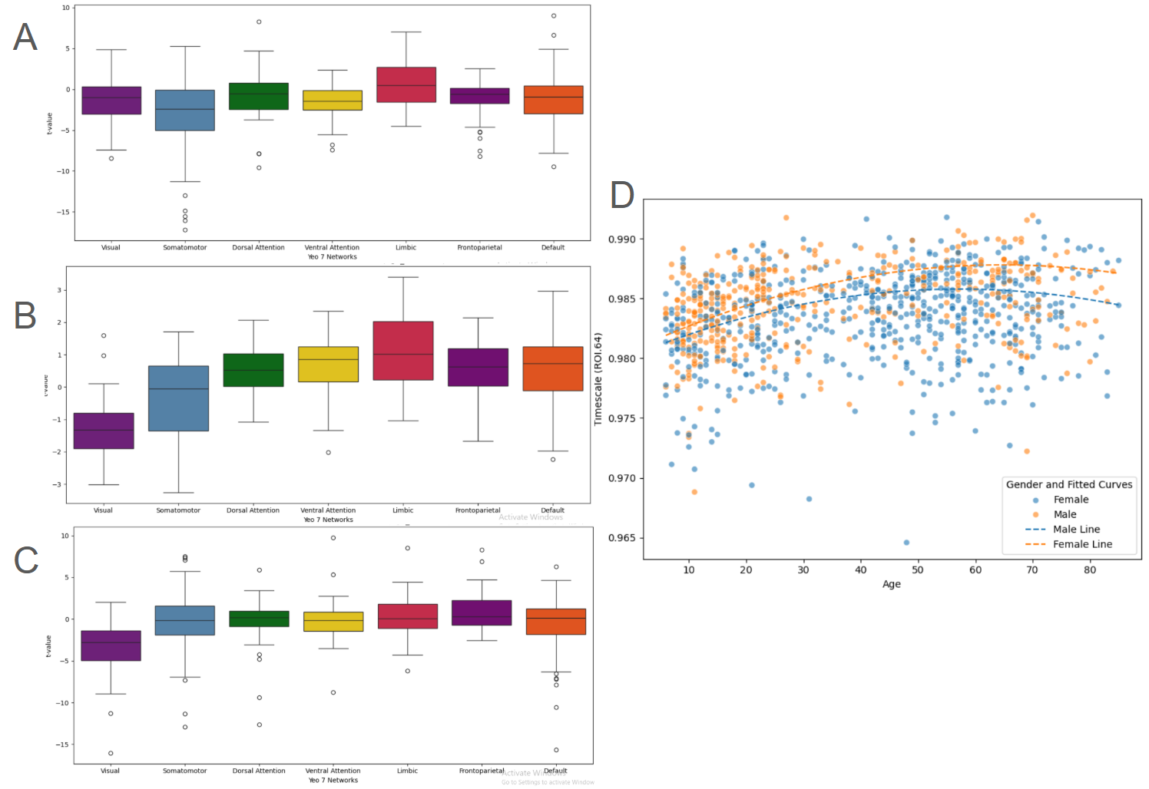
Inverted-U Age Pattern
Visual Somatomotor Dorsal Attn Ven Attn Limbic Frontoparietal Default
TR=645
• INTs increase → peak → decline with age
TR=1400
TR=2500
Visual Somatomotor Dorsal Attn Ven Attn Limbic Frontoparietal Default
Notes:
Looking at age effects, we see an intriguing inverted-U pattern: INTs increase during childhood and adolescence, peak in early adulthood, and decline with age. This pattern is especially pronounced in sensory and salience regions, suggesting that temporal processing capacity changes dynamically across the lifespan.

Slide 17
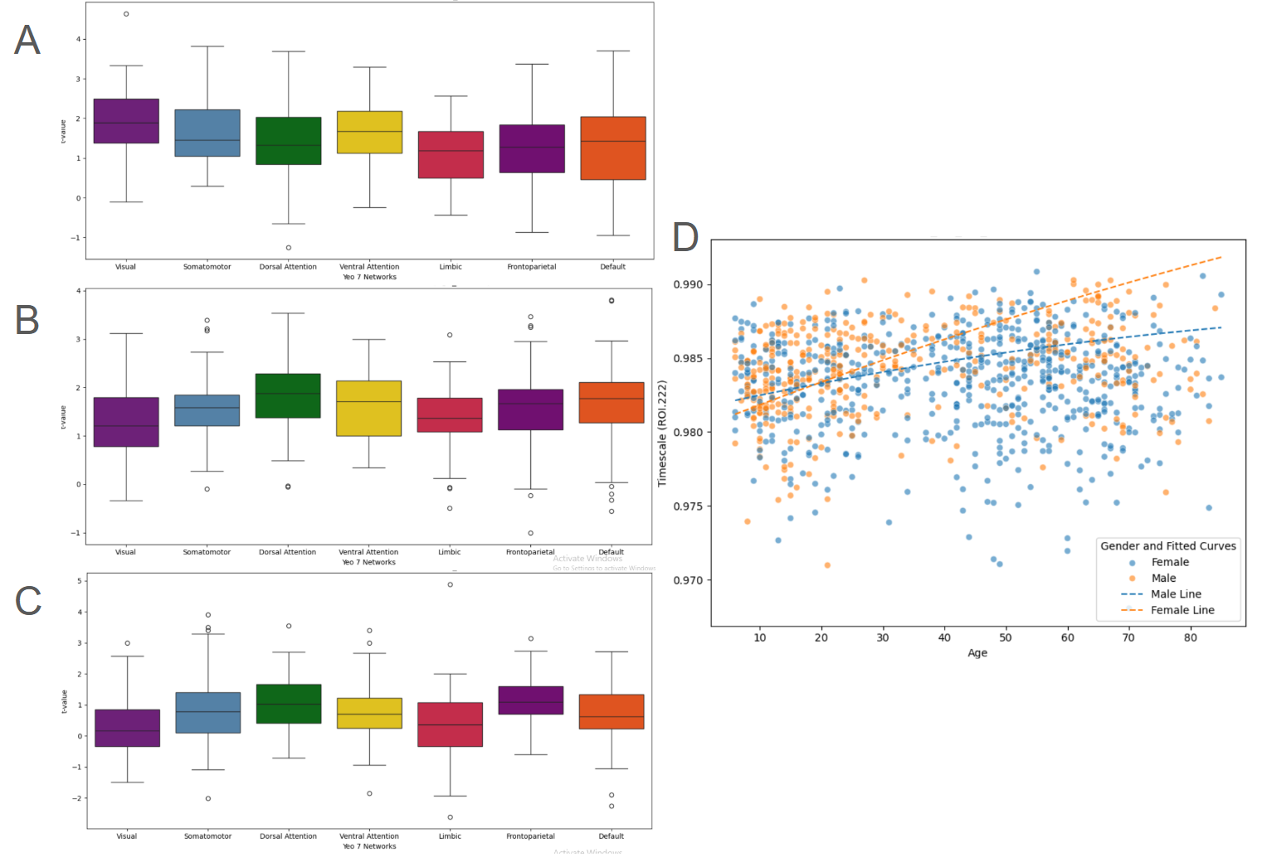
Sex and Age Interaction Effects on INT (AR1) in Yeo 7 Networks
Visual Somatomotor Dorsal Attn Ven Attn Limbic Frontoparietal Default
TR=645
• Sex × Age interactions vary by region
TR=1400
TR=2500
Visual Somatomotor Dorsal Attn Ven Attn Limbic Frontoparietal Default
Notes:
We also found localized effects of sex and interactions between sex and age. These effects vary by brain region and temporal resolution, indicating that both biological sex and developmental stage shape the brain’s temporal dynamics in nuanced ways.

Slide 18
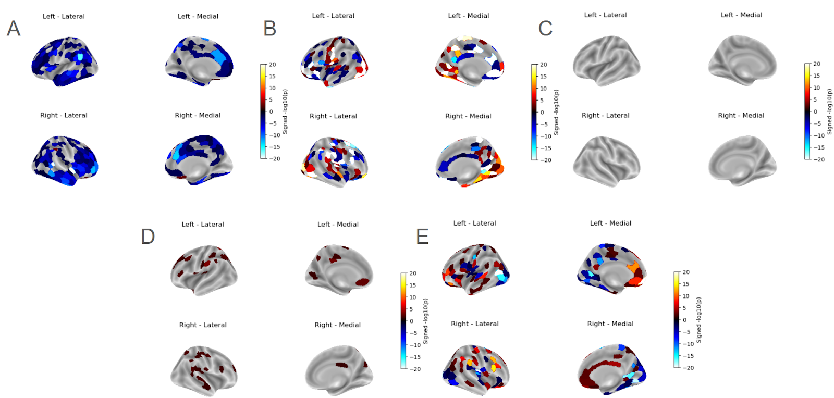
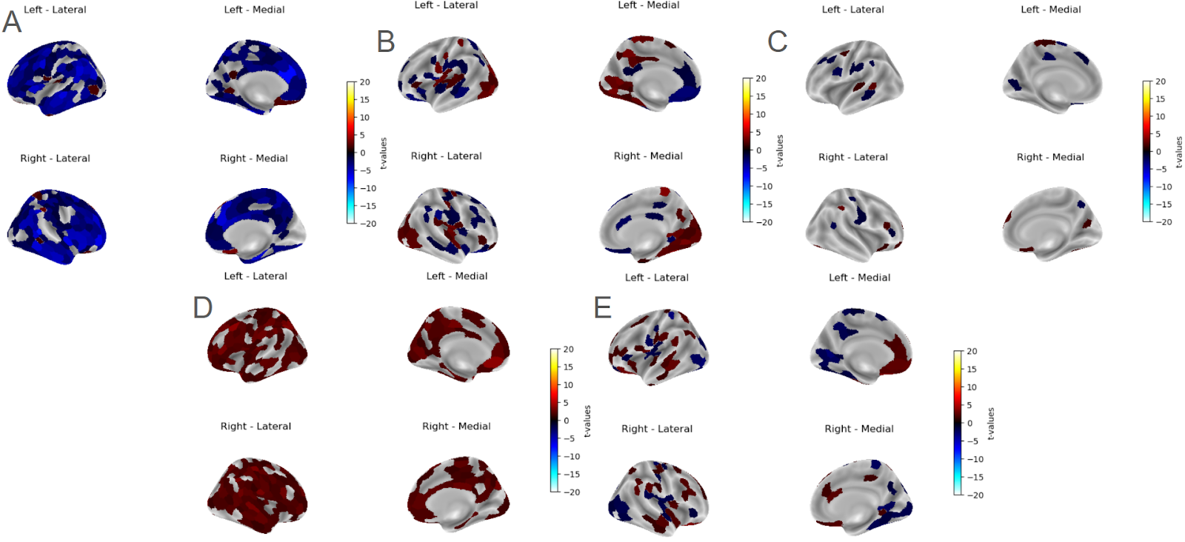
Statistical Modeling @ TR=1400 ms
-log(P)
T maps
Head Motion
Age
Sex
Head Motion
Age
Sex
Age*Sex
Age Quadratic
Age*Sex
Age Quadratic

Slide 19
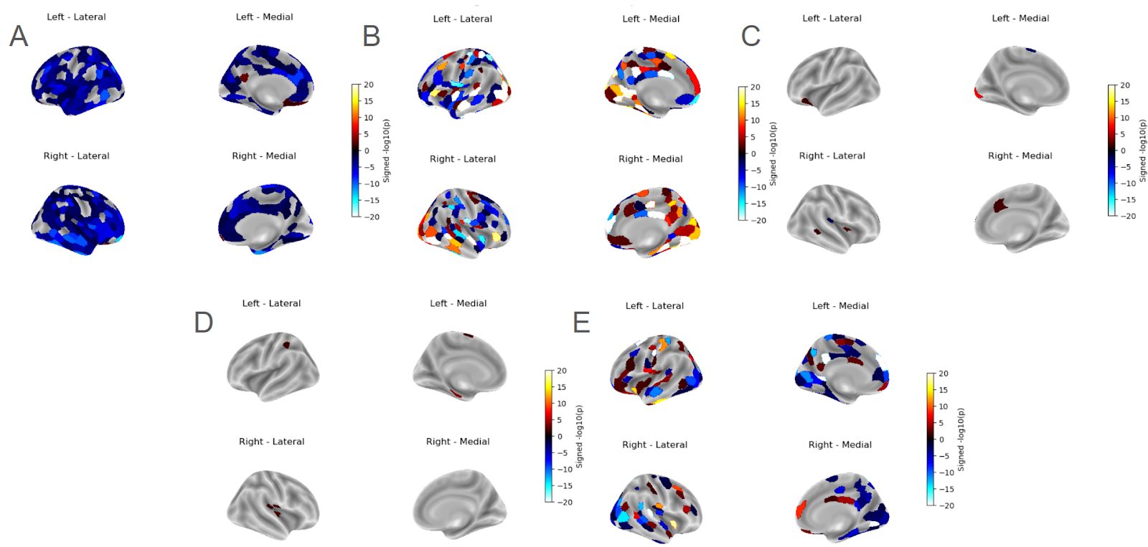
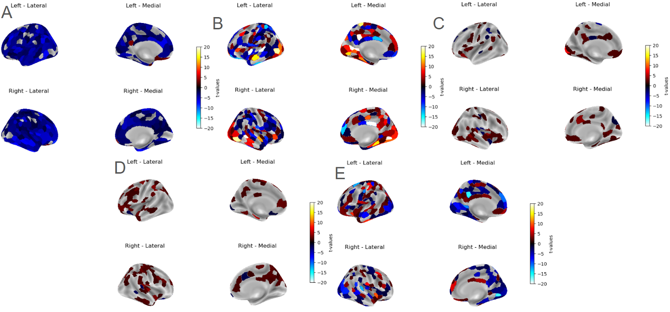
Statistical Modeling @ TR=2500 ms
-log(P)
T maps
Head Motion
Age
Sex
Head Motion
Age
Sex
Age*Sex
Age Quadratic
Age*Sex
Age Quadratic

Slide 20



T-maps Comparison
Head Motion
Sex
Age Quadratic
Visual Somatomotor Dorsal Attn Ven Attn Limbic Frontoparietal Default
Visual Somatomotor Dorsal Attn Ven Attn Limbic Frontoparietal Default
Visual Somatomotor Dorsal Attn Ven Attn Limbic Frontoparietal Default
TR=645
TR=645
TR=645
TR=1400
TR=1400
TR=1400
TR=2500
TR=2500
TR=2500
Visual Somatomotor Dorsal Attn Ven Attn Limbic Frontoparietal Default
Visual Somatomotor Dorsal Attn Ven Attn Limbic Frontoparietal Default
Visual Somatomotor Dorsal Attn Ven Attn Limbic Frontoparietal Default
Notes:
Age Quadratic is more reliable than Sex. This robustness supports the use of INTs as reliable biomarkers in both research and clinical contexts.

Slide 21






Notes:
• INTs = robust brain signature
• Support lifespan and clinical applications
Our results suggest that INTs could be used as biomarkers for early detection of cognitive decline.
To summarize: INTs provide a robust, reproducible signature of brain dynamics. They support applications across the lifespan and in clinical populations. Looking ahead, future work could explore INT directionality, longitudinal changes, and even applications in artificial intelligence.

Slide 22
Conclusion
Most reliable INT → AR1
01
Age has non linear effect and sex has not meaningful effect, but age and sex interaction does
02
Summarized developmental trend at network level
03
Notes:
Potential Diagnostic for Neural Disorders

Slide 23
Thank You
Questions?

